Slide 2
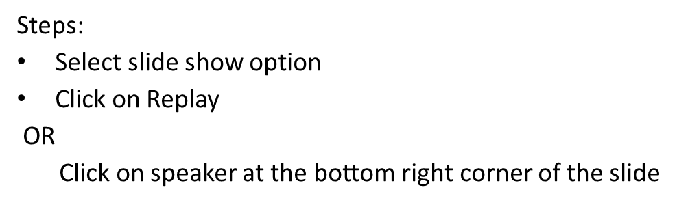

Chapter 9: Virtual Memory

Slide 3
Background
Virtual memory – separation of user logical memory from physical memory.
Only part of the program needs to be in memory for execution
Logical address space can therefore be much larger than physical address space
Allows address spaces to be shared by several processes
Allows for more efficient process creation
Virtual memory can be implemented via:
Demand paging
Demand segmentation

Slide 4
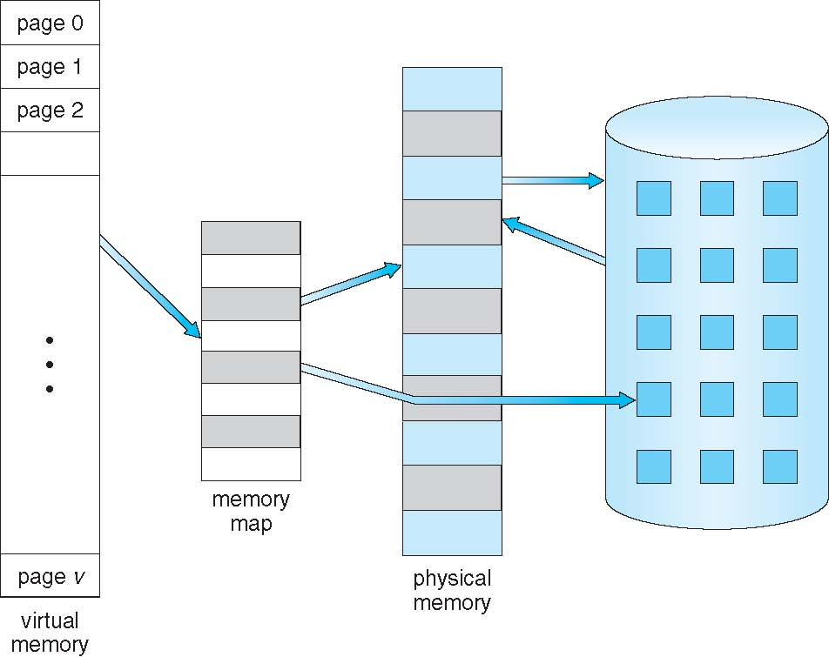
Virtual Memory That is Larger Than Physical Memory

Slide 5
The ability to execute a program that is only partially in memory would confer many benefits:
A program would no longer be constrained by the amount of physical memory that is available.
Because each user program could take less physical memory, more programs could be run at the same time, with a corresponding increase in CPU utilization and throughput
Less I/O would be needed to load or swap user programs into memory, so each user program would run faster.

Slide 6
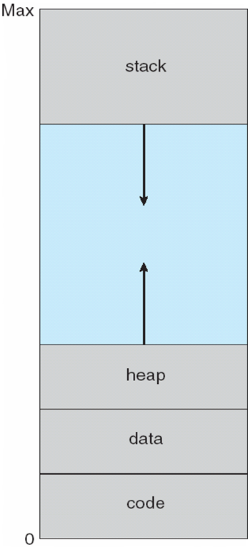
Virtual-address Space
The large blank space (or hole) between the heap and the stack is part of the virtual address space.
Virtual address spaces that include holes are known as sparse address spaces.
Using a sparse address space is beneficial because the holes can be filled as the stack or heap segments grow or if we wish to dynamically link libraries during program execution.

Slide 7
Virtual memory allows files and memory to be shared by two or more processes through page sharing
Benefits:
System libraries can be shared by several processes through mapping
of the shared object into a virtual address space.
Virtual memory can allow pages to be shared during process creation with the fork() system call thus speeding up process creation.

Slide 8
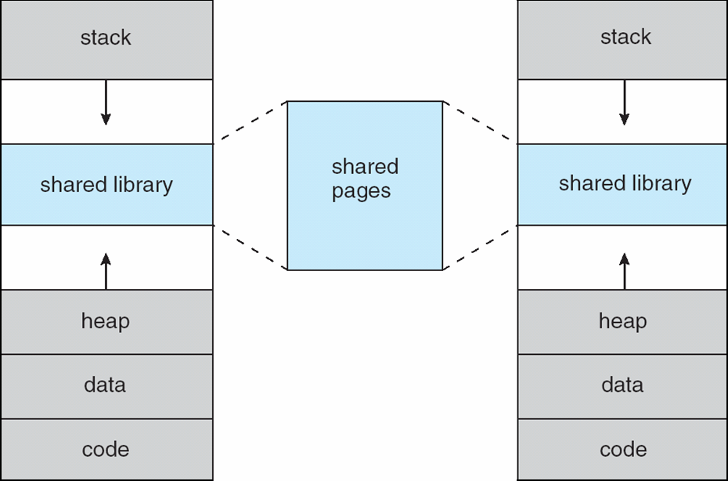
Shared Library Using Virtual Memory

Slide 9
Demand Paging
Bring a page into memory only when it is needed for execution.
A demand-paging system is similar to a paging system with swapping.
Less I/O needed
Less memory needed
Faster response (no need to wait for all pages to load)
More users
Rather than swapping the entire process into memory, however, we use a lazy swapper. A lazy swapper never swaps a page into memory unless that page will be needed.
Since we are now viewing a process as a sequence of pages, rather than as one large contiguous address space, use of the term swapper is technically incorrect.

Slide 10
When a process is to be swapped in, the pager guesses which pages will be used before the process is swapped out again.
Instead of swapping in a whole process, the pager brings only those pages into memory.
Thus, it avoids reading into memory pages that will not be used anyway, decreasing the swap time and the amount of physical memory needed.

Slide 11
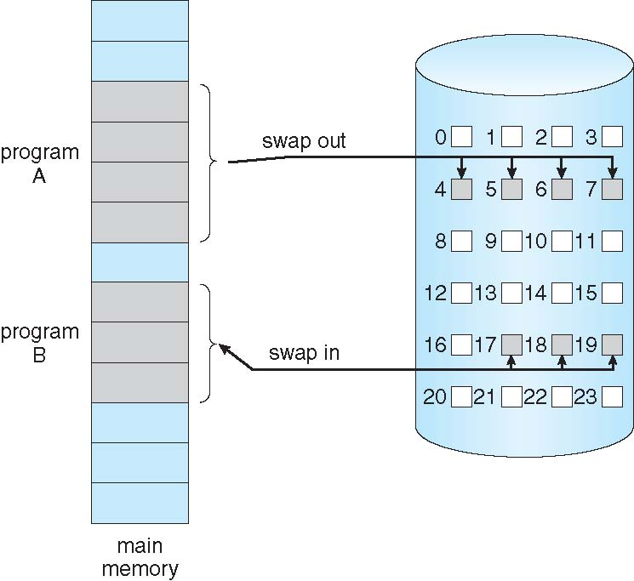
Transfer of a Paged Memory to Contiguous Disk Space

Slide 12
Valid-Invalid Bit
With each page table entry a valid–invalid bit is associated (v ⇒ in-memory, i ⇒ not-in-memory)
Initially valid–invalid bit is set to i on all entries
Frame #
valid-invalid bit
v
v
v
v
i
….
i
i
page table

Slide 13
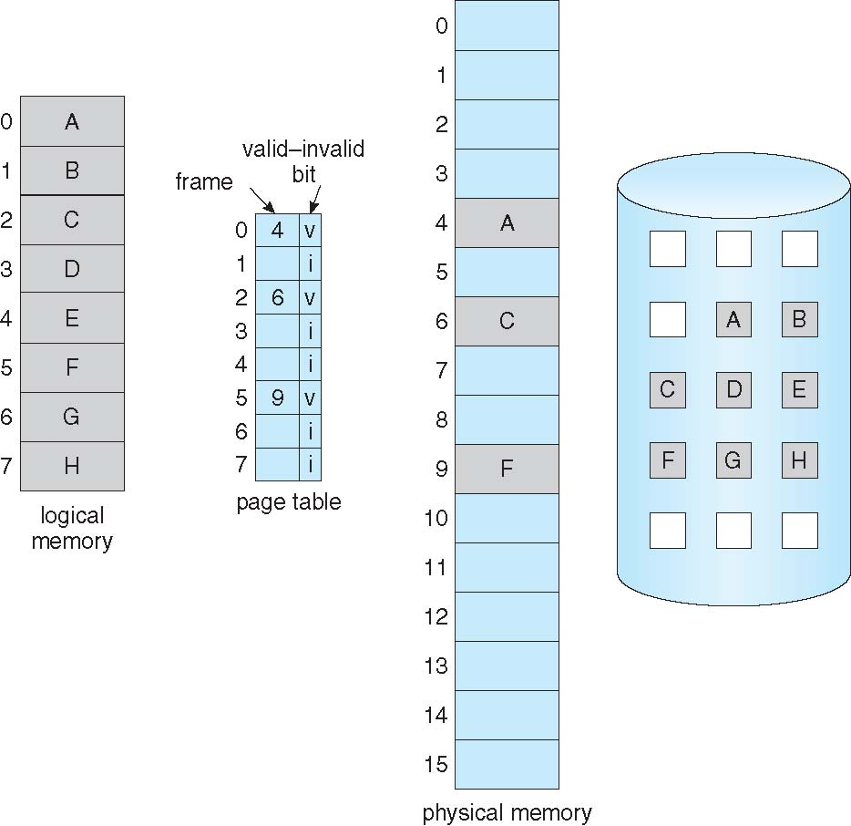
Page Table When Some Pages Are Not in Main Memory

Slide 14
Page Fault
If there is a reference to a page, first reference to that page will trap to operating system:
page fault
Instead of swapping in a whole process, the pager brings only those pages into memory. Thus, it avoids reading into memory pages that will not be used anyway, decreasing the swap time and the amount of physical memory needed.
OS check an internal table for this process to determine whether the reference was a valid or an invalid memory access.
If have not yet brought in that page(invalid), we now page it in.
Swap page into frame
Reset tables
Set validation bit = v
Restart the instruction that caused the page fault

Slide 15
To compute the effective access time, we must know how much time is needed to service a page fault. A page fault causes the following sequence to occur:
1.Trap to the operating system.
2.Determine that the interrupt was a page fault.
3.Save the user registers and process state.
4.Check that the page reference was legal and determine the location of the
page on the disk
5.Issue a read from the disk to a free frame:
a. Wait in a queue for this device until the read request is serviced.
b. Wait for the device seek and/ or latency time.
c. Begin the transfer of the page to a free frame.

Slide 16
6.While waiting, allocate the CPU to some other user (CPU scheduling,
optional).
7.Receive an interrupt from the disk I/0 subsystem (I/0 completed).
8.Save the registers and process state for the other user (if step 6 is executed).
9.Determine that the interrupt was from the disk
10.Correct the page table and other tables to show that the desired page is
now in memory.
11.Wait for the CPU to be allocated to this process again.
12.Restore the user registers, process state, and new page table, and then
resume the interrupted instruction.

Slide 17
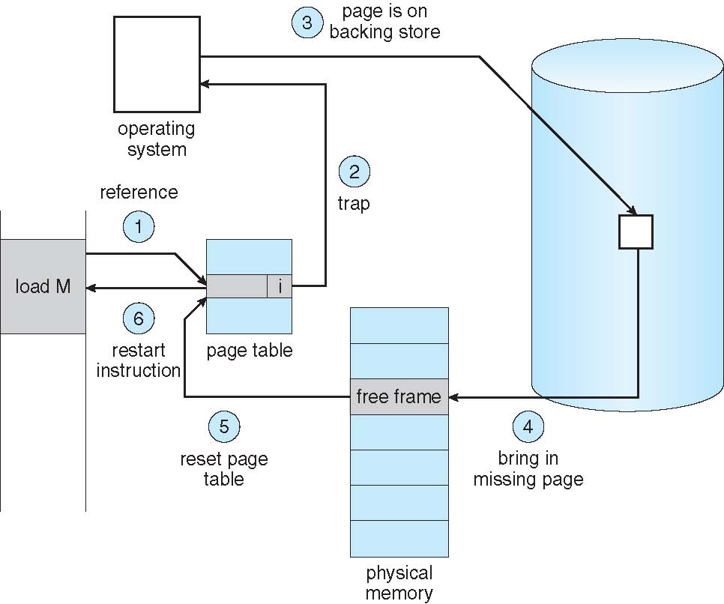
Steps in Handling a Page Fault

Slide 18
Performance of Demand Paging
Page Fault Rate 0 ≤ p ≤ 1.0
if p = 0 no page faults (all pages are in MM)
if p = 1, every reference is page fault
Effective Access Time (EAT)
EAT = (1 – p) x memory access
+ p (page fault overhead
+ swap page out
+ swap page in
+ restart overhead
)

Slide 19
Demand Paging Example
Memory access time = 200 nanoseconds
Average page-fault service time = 8 milliseconds
EAT = (1 – p) x 200 + p (8 milliseconds)
= (1 – p ) x 200 + p x 8,000,000
= 200 + p x 7,999,800
If one access out of 1,000 causes a page fault, then ie..p=(1/1000)=0.001
EAT = 8.2 microseconds.

Slide 20
Copy-on-Write
The fork() system call creates a child process that is a duplicate of its parent. Traditionally, fork() worked by creating a copy of the parent’s address space for the child, duplicating the pages belonging to the parent. However, considering that many child processes invoke the exec() system call immediately after creation, the copying of the parent's address space may be unnecessary.

Slide 21
Copy-on-Write
Virtual memory allows other benefits during process creation:
- Copy-on-Write
Copy-on-Write allows both parent and child processes to initially share the same pages in memory. If either process modifies a shared page, a copy of the shared page is copied.
Copy-on-Write allows more efficient process creation as only modified pages are copied
When it is determined that a page is going to be duplicated using copy on-write, uses free poll of space.
Operating systems typically allocate these pages using a technique known as zero-fill-on-demand

Slide 22
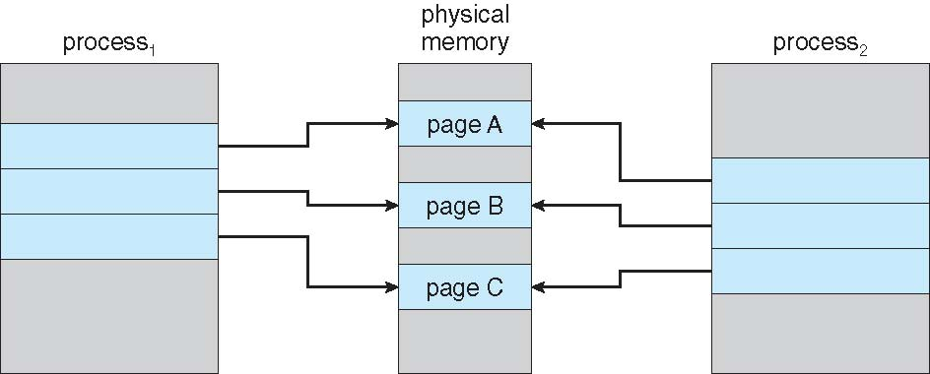
Before Process 1 Modifies Page C

Slide 23
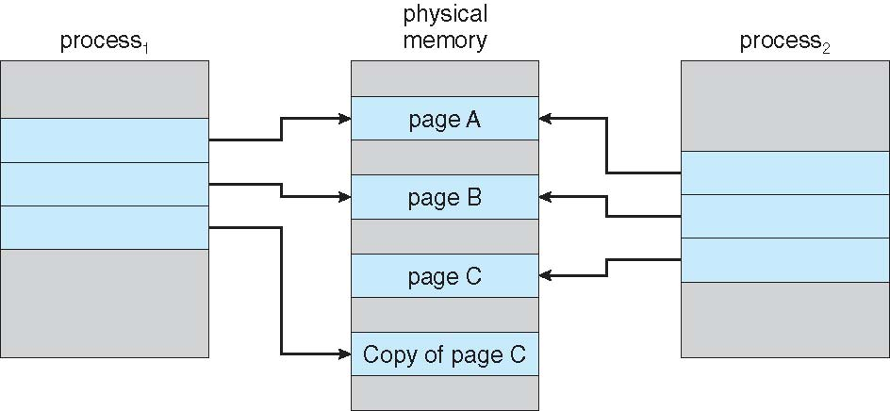
After Process 1 Modifies Page C

